Slide 1
CS 1674: Intro to Computer Vision Geometric Transformations and Multiple Views
Prof. Adriana Kovashka University of Pittsburgh
October 9, 2018

Slide 2
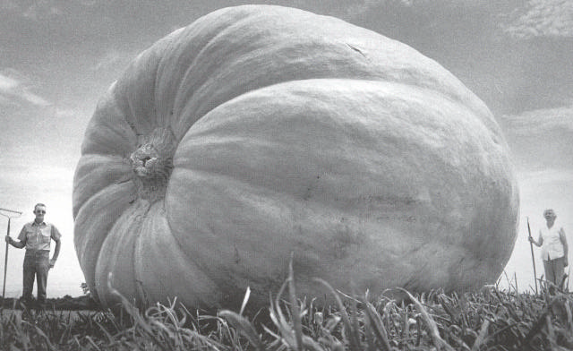
Why multiple views?
Structure and depth are inherently ambiguous from single views.
Multiple views help us to perceive 3d shape and depth.
Kristen Grauman, images from Svetlana Lazebnik

Slide 3
Alignment problem
We previously discussed how to match features across images, of the same or different objects
Now let’s focus on the case of “two images of the same object”(e.g. x_{i} and x_{i}’)
What transformation relates x_{i} and x_{i}’?
In alignment, we will fit the parameters of some transformation according to a set of matching feature pairs (“correspondences”).
x_{i}
x_{i}
'
T
Adapted from Kristen Grauman and Derek Hoiem

Slide 4
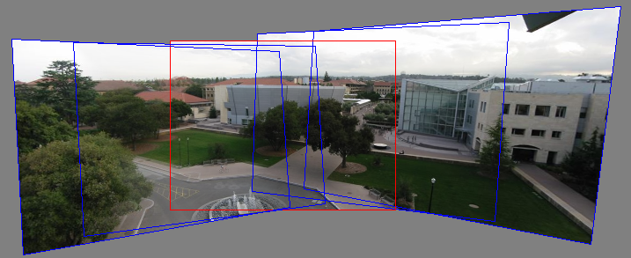
Motivation: Image mosaics
Kristen Grauman
Image from http://graphics.cs.cmu.edu/courses/15-463/2010_fall/

Slide 5
First, what are the correspondences?
Min dist = match
?
Compare content in local patches, find best matches.
Scan x_{i}’ with template formed from a point in x_{i}, and compute e.g. Euclidean distance between pixel intensities in the patch
Or compare SIFT features
Adapted from Kristen Grauman

Slide 6
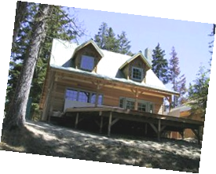
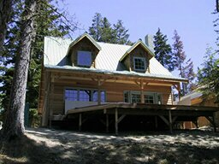
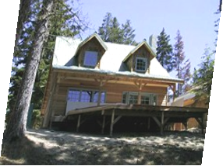
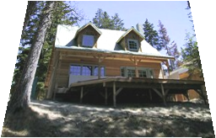
Second, what are the transformations?
Examples of transformations:
translate
rotate
change aspect ratio
squish
change perspective
Adapted from Alyosha Efros

Slide 7
Parametric (global) warping
T
p = (x,y)
p’ = (x’,y’)
Transformation T is a coordinate-changing machine:
p’ = T(p)
What does it mean that T is global?
It is the same for any point p
It can be described by just a few numbers (parameters)
Let’s represent T as a matrix:
p’ = Mp
Alyosha Efros

Slide 8
Scaling
Scaling a coordinate means multiplying each of its components by a scalar
Uniform scaling means this scalar is the same for all components:
× 2
(4, 2)
(2, 1)
Adapted from Alyosha Efros

Slide 9
Scaling
Non-uniform scaling: different scalars per component
X × 2, Y × 0.5
(2, 1)
(4, 0.5)
Adapted from Alyosha Efros

Slide 10
Scaling
Scaling operation:
Or, in matrix form:
scaling matrix S
x’ = mx + ny
y’ = px + qy
Adapted from Alyosha Efros

Slide 11
2D Linear transformations
Only linear 2D transformations can be represented with a 2x2 matrix.
Linear transformations are combinations of …
Scale,
Rotation,
Shear, and
Mirror
Alyosha Efros

Slide 12
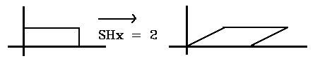
What transforms can we write w/ 2x2 matrix?
2D Scaling?
2D Rotate around (0,0)? (see hidden slide)
2D Shear?
Modified from Alyosha Efros
Fig. from https://www.siggraph.org/education/materials/HyperGraph/modeling/mod_tran/2dshear.htm

Slide 13
EXTRA: How to write 2-D rotation
Polar coordinates…
x = r cos (φ)
y = r sin (φ)
x’ = r cos (φ + θ)
y’ = r sin (φ + θ)
Trig Identity…
x’ = r cos(φ) cos(θ) – r sin(φ) sin(θ)
y’ = r sin(φ) cos(θ) + r cos(φ) sin(θ)
Substitute…
x’ = x cos(θ) - y sin(θ)
y’ = x sin(θ) + y cos(θ)
(x’, y’)
(x, y)
θ
φ
Derek Hoiem

Slide 14
What transforms can we write w/ 2x2 matrix?
2D Mirror about Y axis?
2D Mirror over (0,0)?
2D Translation?
CAN’T DO!
Alyosha Efros

Slide 15
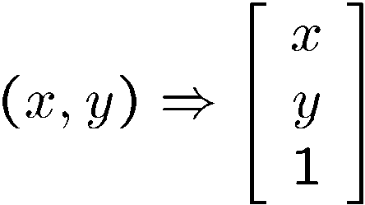
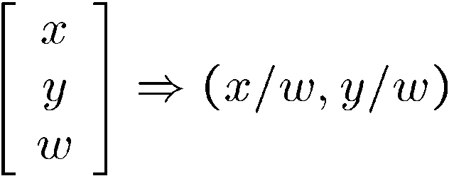
Homogeneous coordinates
To convert to homogeneous coordinates:
homogeneous image
coordinates
Converting from homogeneous coordinates
Kristen Grauman

Slide 16
Translation
Homogeneous Coordinates
t_{x} = 2 t_{y} = 1
(4, 2)
(2, 1)
Adapted from Alyosha Efros

Slide 17
2D affine transformations
Affine transformations are combinations of …
Linear transformations, and
Translations
Maps lines to lines, parallel lines remain parallel
Adapted from Alyosha Efros

Slide 18
Fitting an affine transformation
Assuming we know the correspondences, how do we get the transformation?
Alyosha Efros

Slide 19
Fitting an affine transformation
How many matches (correspondence pairs) do we need to solve for the transformation parameters?
Once we have solved for the parameters, how do we compute given ?
Adapted from Kristen Grauman

Slide 20




Detour: Keypoint matching for search
In database
1. Find a set of distinctive key- points
Query
A₁
B₃
2. Define a region around each keypoint (window)
A₂
A₃
B₁
B₂
3. Compute a local descriptor from the region
4. Match descriptors

Slide 21

Detour: solving for translation with outliers
A₁
A₂
A₃
B₁
B₂
B₃
Given matched points in {A} and {B}, estimate the translation of the object
Derek Hoiem

Slide 22
Detour: solving for translation with outliers
A₁
A₅
B₄
A₂
A₃
(t_{x}, t_{y})
B₁
A₄
B₂
B₃
B₅
Problem: outliers
Hough transform solution
Initialize a grid of parameter values
Each matched pair casts a vote for consistent values
Find the parameters with the most votes
Adapted from Derek Hoiem

Slide 23
Detour: solving for translation with outliers
B₄
A₁
B₅
B₆
A₂
A₃
(t_{x}, t_{y})
B₁
A₄
B₂
B₃
A₅
A₆
Problem: multiple objects
Hough transform solution
Initialize a grid of parameter values
Each matched pair casts a vote for consistent values
Find the parameters with the most votes
Adapted from Derek Hoiem

Slide 24
2D projective transformations
Projective transformations:
Affine transformations, and
Projective warps
Parallel lines do not necessarily remain parallel
Kristen Grauman

Slide 25
Projective transformations
A projective transformation is a mapping between any two projective planes with the same center of projection
Also called Homography
PP2
p’
H
p
PP1
Adapted from Alyosha Efros

Slide 26
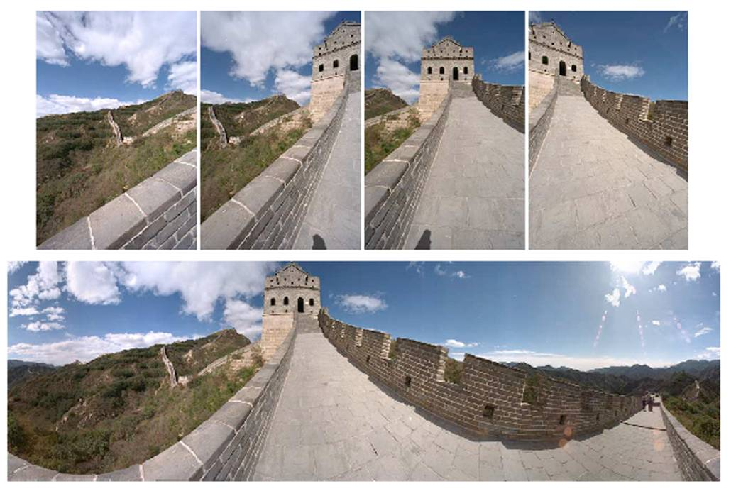
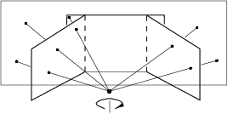

Image mosaics: Goals
. . .
image from S. Seitz
Obtain a wider angle view by combining multiple images.
Kristen Grauman

Slide 27

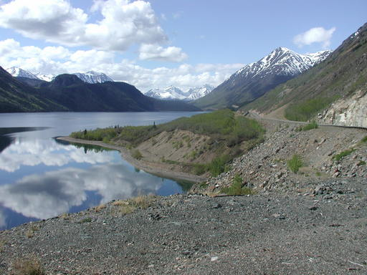
Image mosaics: Camera setup
Two images with camera rotation but no translation
(0, 0)
(0, 0)
(50, 70)
(50, 20)
Camera Center
Adapted from Derek Hoiem

Slide 28
Image mosaics: Many 2D views, one 3D object
mosaic plane
The mosaic has a natural interpretation in 3D
The images are reprojected onto a common plane
The mosaic is formed on this plane
Mosaic is a synthetic wide-angle camera
Steve Seitz

Slide 29
How to stitch together panorama (mosaic)?
Basic Procedure
Take a sequence of images from the same position
Rotate the camera about its optical center
Compute the homography (transformation) between first and second image
Transform the second image to overlap with the first
Blend the two together to create a mosaic
(If there are more images, repeat)
Adapted from Steve Seitz

Slide 30
Computing the homography
…
…
To compute the homography given pairs of corresponding points in the images, we need to set up an equation where the parameters of H are the unknowns…
Kristen Grauman

Slide 31
Computing the homography
Assume we have four matched points: How do we compute homography H?
p’=Hp
Can set scale factor h₉ = 1.
So, there are 8 unknowns.
Need at least 8 eqs, but the more the better…
A
DEMO
Adapted from Derek Hoiem, Kristen Grauman
Derivation: http://www.cse.psu.edu/~rtc12/CSE486/lecture16.pdf

Slide 32
How to stitch together panorama (mosaic)?
Basic Procedure
Take a sequence of images from the same position
Rotate the camera about its optical center
Compute the homography (transformation) between first and second image
Transform the second image to overlap with the first
Blend the two together to create a mosaic
(If there are more images, repeat)
Adapted from Steve Seitz

Slide 33
Transforming the second image
Image 1
Image 2 canvas
To apply a given homography H
Compute p’ = Hp (regular matrix multiply)
Convert p’ from homogeneous to image coordinates
p’
H
p
Modified from Kristen Grauman

Slide 34
Transforming the second image
Image 1
Image 2 canvas
H(x,y)
y
y’
x
x’
f(x,y)
g(x’,y’)
Forward warping:
Send each pixel f(x,y) to its corresponding location
(x’,y’) = H(x,y) in the right image
Modified from Alyosha Efros

Slide 35
Transforming the second image
H(x,y)
y
y’
x
x’
f(x,y)
g(x’,y’)
Forward warping:
Send each pixel f(x,y) to its corresponding location
(x’,y’) = H(x,y) in the right image
Q: what if pixel lands “between” two pixels?
A: distribute color among neighboring pixels (x’,y’)
Alyosha Efros

Slide 36
Transforming the second image
Image 1
Image 2 canvas
H⁻¹(x,y)
y
y’
x
x
x’
f(x,y)
g(x’,y’)
Inverse warping:
Get each pixel g(x’,y’) from its corresponding location
(x,y) = H⁻¹(x’,y’) in the left image
Modified from Alyosha Efros

Slide 37
Transforming the second image
H⁻¹(x,y)
y
y’
x
x
x’
f(x,y)
g(x’,y’)
Inverse warping:
Get each pixel g(x’,y’) from its corresponding location
(x,y) = H⁻¹(x’,y’) in the left image
Q: what if pixel comes from “between” two pixels?
A: interpolate color value from neighbors
Alyosha Efros

Slide 38
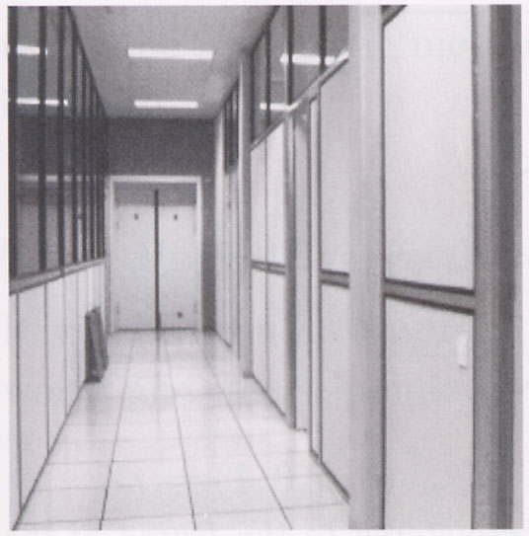
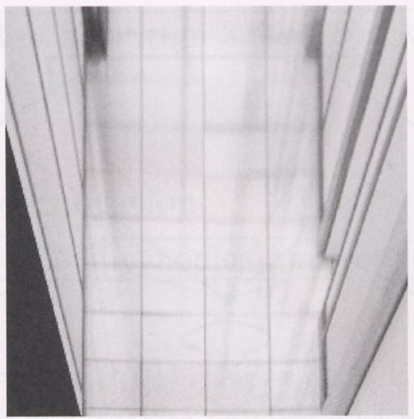
Homography example: Image rectification
p’
p
To unwarp (rectify) an image solve for homography H given p and p’: p’=Hp
Derek Hoiem

Slide 39
Summary of affine/projective transforms
Write 2d transformations as matrix-vector multiplication (including translation when we use homogeneous coordinates)
Fitting transformations: solve for unknown parameters given corresponding points from two views – linear, affine, projective (homography)
Mosaics: uses homography and image warping to merge views taken from same center of projection
Perform image warping (forward, inverse)
Adapted from Kristen Grauman

Slide 40
Next: Stereo vision
Homography: Same camera center, but camera rotates
Stereo vision: Camera center is not the same (we have multiple cameras)
Epipolar geometry
Relates cameras from two positions/cameras
Stereo depth estimation
Recover depth from disparities between two images
Adapted from Derek Hoiem

Slide 41
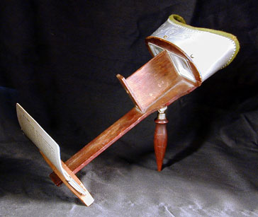
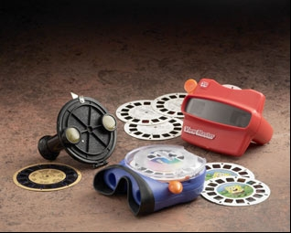
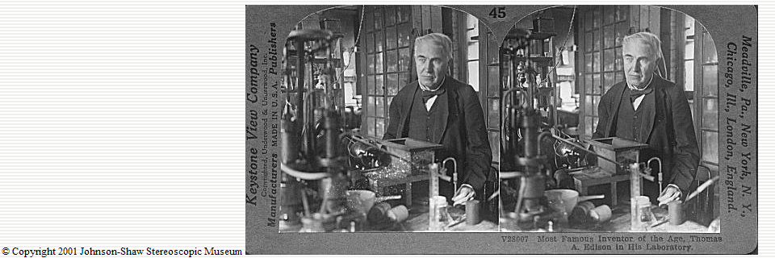
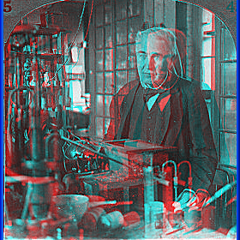
Stereo photography and stereo viewers
Take two pictures of the same subject from two slightly different viewpoints and display so that each eye sees only one of the images.
Invented by Sir Charles Wheatstone, 1838
Image from fisher-price.com
Kristen Grauman

Slide 42
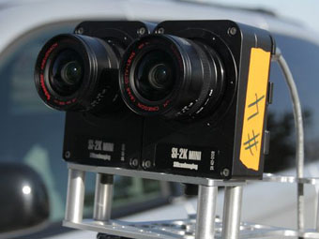
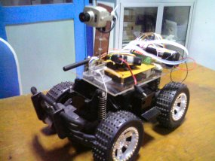
Depth from stereo for computers
Two cameras, simultaneous views
Single moving camera and static scene
Kristen Grauman

Slide 43
Depth from stereo
Goal: recover depth by finding image coordinate x’ that corresponds to x
X
X
x
z
x
x’
x'
f
f
C
Baseline B
C’
Derek Hoiem

Slide 44
Depth from stereo
Goal: recover depth by finding image coordinate x’ that corresponds to x
Sub-Problems
Calibration: How do we recover the relation of the cameras (if not already known)?
Correspondence: How do we search for the matching point x’?
Estimate depth from matches
X
x
x'
Derek Hoiem

Slide 45
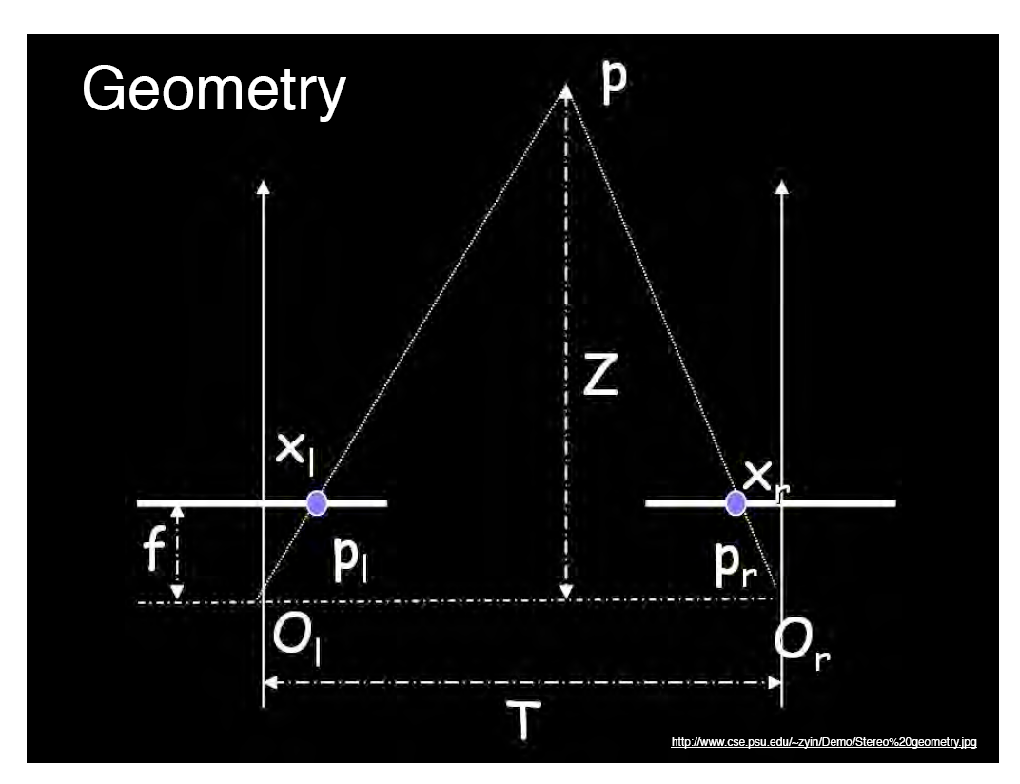
Geometry for a simple stereo system
Assume parallel optical axes, known camera parameters (i.e., calibrated cameras). What is expression for Z?
Similar triangles (p_{l}, P, p_{r}) and (O_{l}, P, O_{r}):
depth
Depth is inversely proportional to disparity.
disparity
Adapted from Kristen Grauman
Notes:
45

Slide 46
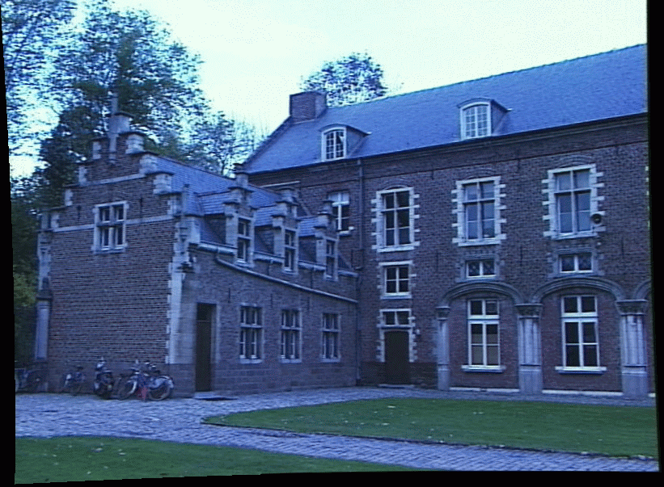
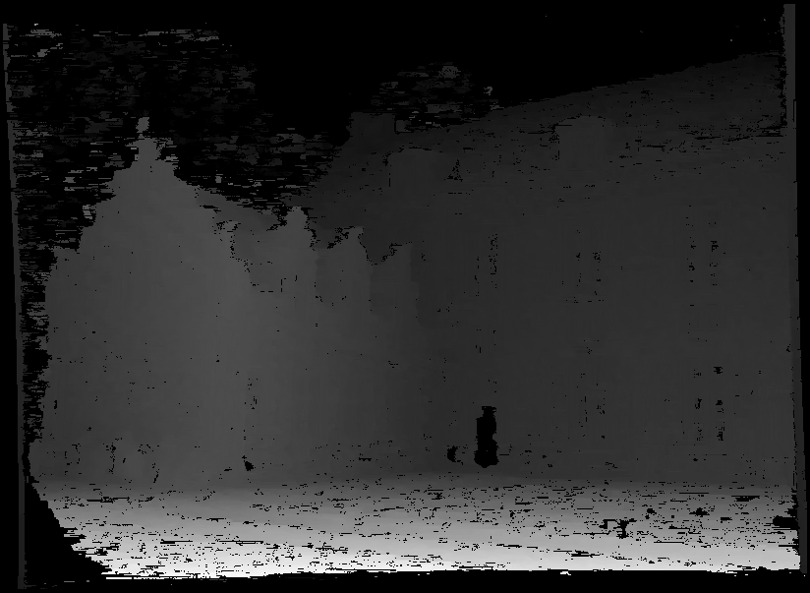
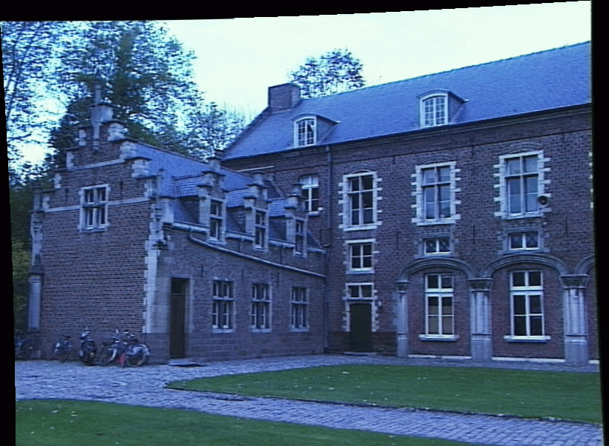
Depth from disparity
We have two images from different cameras.
If we could find the corresponding points in two images, we could estimate relative depth…
How do we match a point in the first image to a point in the second efficiently?
image I(x,y)
Disparity map D(x,y)
image I´(x´,y´)
Kristen Grauman

Slide 47
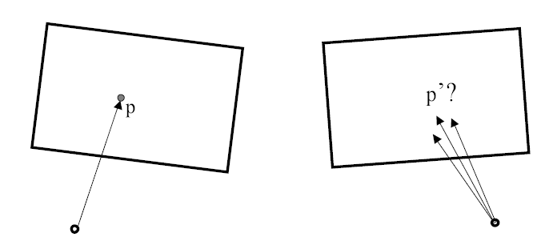
Stereo correspondence constraints
Given p in left image, where can corresponding point p’ be?
Kristen Grauman

Slide 48
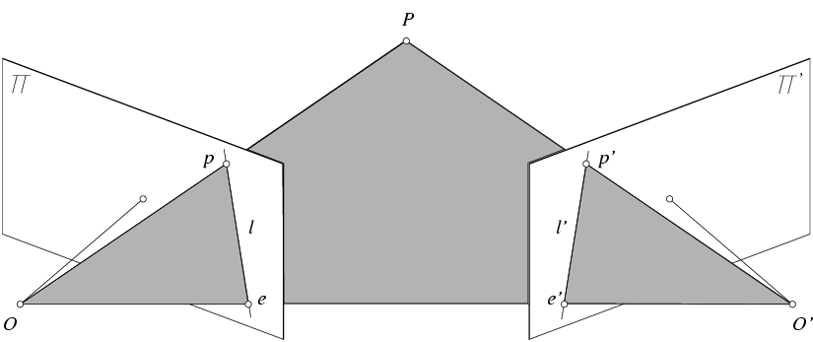
Epipolar geometry: notation
P
p
p’
Baseline – line connecting the two camera centers
Epipoles
= intersections of baseline with image planes
= projections of the other camera center
Epipolar Plane – plane containing baseline
Epipolar Lines - intersections of epipolar plane with image planes (always come in corresponding pairs)
Adapted from Derek Hoiem

Slide 49
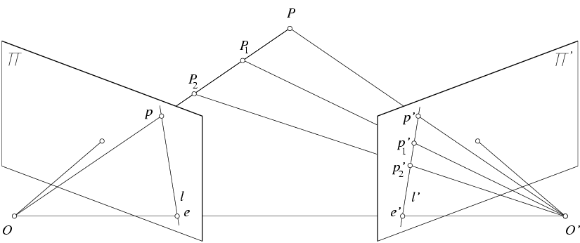
Epipolar constraint
world point
first image plane
second image plane
Geometry of two views constrains where the corresponding pixel for some image point in the first view must occur in the second view.
It must be on the line where (1) the plane connecting the world point and optical centers, and (2) the image plane, intersect.
Potential matches for p have to lie on the corresponding line l’.
Potential matches for p’ have to lie on the corresponding line l.
Adapted from Kristen Grauman, Derek Hoiem
Notes:
49

Slide 50
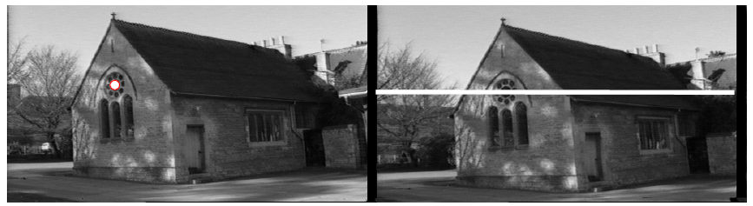
Epipolar constraint
The epipolar constraint is useful because
it reduces the correspondence problem
to a 1D search along an epipolar line.
Kristen Grauman, image from Andrew Zisserman

Slide 51
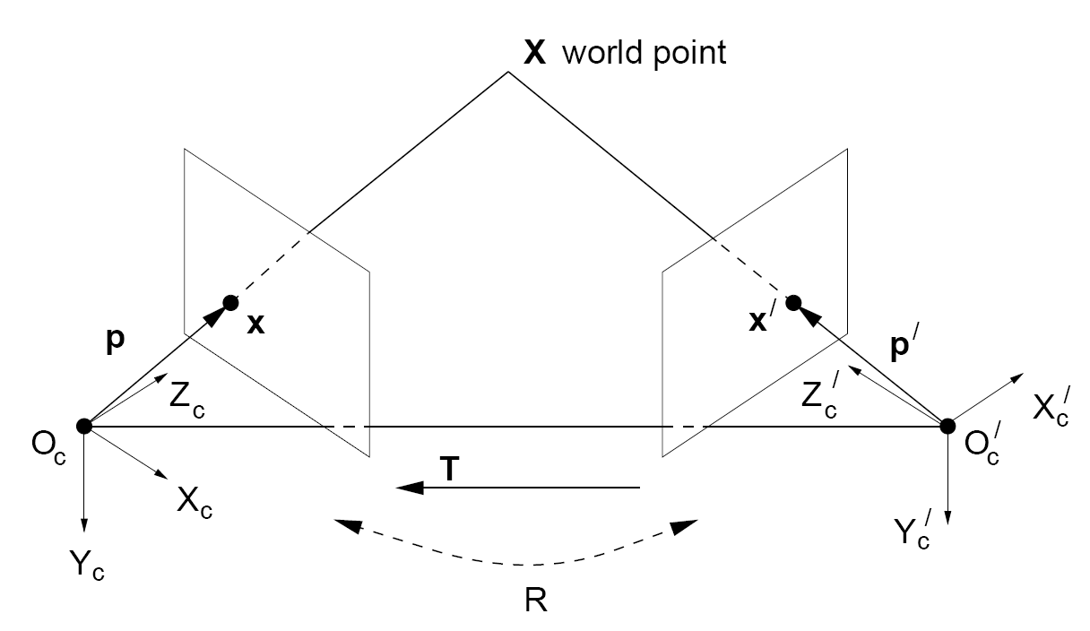
Stereo geometry, with calibrated cameras
If the stereo rig is calibrated, we know how to rotate and translate camera reference frame 1 to get to camera reference frame 2
Rotation: 3x3 matrix R; translation: 3x1 vector T.
(See hidden slides for how we get to the next slide.)
Adapted from Kristen Grauman
Notes:
51

Slide 52
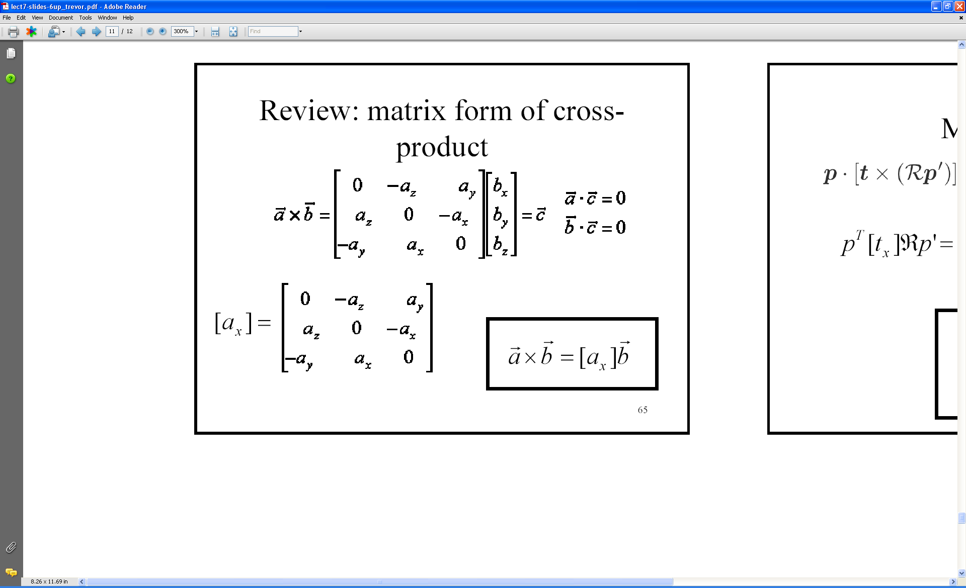
EXTRA: cross product
Vector cross product takes two vectors and returns a third vector that’s perpendicular to both inputs.
So here, c is perpendicular to both a and b, which means the dot product = 0.
Can be expressed as a matrix multiplication.
Kristen Grauman
Notes:
52

Slide 53
EXTRA: From geometry to algebra
Normal to the plane
Cross-product of
vector with itself is 0.
T x X’ normal to plane in which X’ lies, i.e. dot product is 0.
Kristen Grauman
Notes:
53

Slide 54

Essential matrix
Let
E is called the essential matrix, and it relates corresponding image points between both cameras, given the rotation and translation.
Before we said: If we observe a point in one image, its position in other image is constrained to lie on line defined by above. It turns out that:
E^{T}x is the epipolar line l’ through x’ in the second image, corresponding to x.
Ex’ is the epipolar line l through x in the first image, corresponding to x’.
Adapted from Kristen Grauman, Derek Hoiem
Notes:
Note: these points are in camera coordinate systems.
54

Slide 55

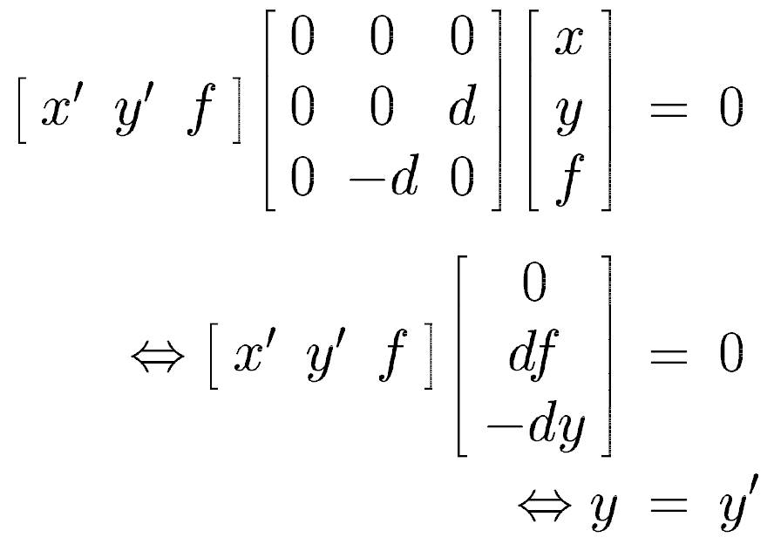
Essential matrix example: parallel cameras
0 0 0
0 0 d
0 –d 0
For the parallel cameras, image of any point must lie on same horizontal line in each image plane.
Kristen Grauman
Notes:
55

Slide 56
image I(x,y)
Disparity map D(x,y)
image I´(x´,y´)
(x´,y´)=(x+D(x,y),y)
Adapted from Kristen Grauman

Slide 57
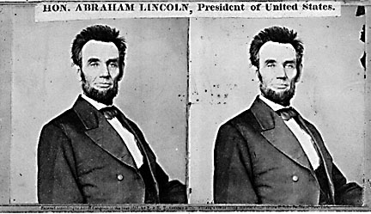
Basic stereo matching algorithm
For each pixel in the first image
Find corresponding epipolar scanline in the right image
Search along epipolar line and pick the best match x’: slide a window along the right scanline and compute Euclidean distance between contents of that window with the reference window in the left image; take the window corresponding to the minimum as the match
Compute disparity x-x’ and set depth(x) = f*T/(x-x’)
Adapted from Derek Hoiem

Slide 58
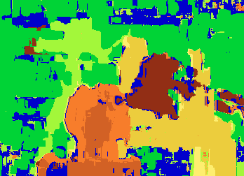

Results with window search
Data
Left image
Right image
Window-based matching
Ground truth
Predicted depth
Ground truth
Derek Hoiem

Slide 59
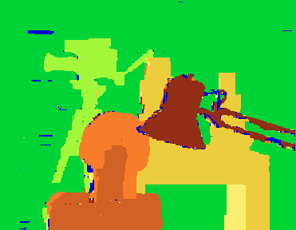
How can we improve?
Uniqueness
For any point in one image, there should be <= 1 matching point in the other image
Ordering
Corresponding points should be in the same order in both views
Smoothness
We expect disparity values to change slowly (for the most part)
Encode these constraints in an energy function and solve using graph cuts.
Graph cuts
Ground truth
Adapted from Derek Hoiem
Y. Boykov, O. Veksler, and R. Zabih, Fast Approximate Energy Minimization via Graph Cuts, PAMI 2001

Slide 60
Summary of stereo vision
Epipolar geometry
Epipoles are intersection of baseline with image planes
Matching point in second image is on a line passing through its epipole
Epipolar constraint limits where points from one view will be imaged in the other, which makes search for correspondences quicker
Essential matrix E maps from a point in one image to a line (its epipolar line) in the other
Stereo depth estimation
Find corresponding points along epipolar scanline
Estimate disparity (depth is inverse to disparity)
Adapted from Kristen Grauman and Derek Hoiem

Slide 61
Projective structure from motion
Given: m images of n fixed 3D points
x_{ij} = P_{i} X_{j} , i = 1,… , m, j = 1, … , n
Problem: estimate m projection matrices P_{i} and n 3D points X_{j} from the mn corresponding 2D points x_{ij}
X_{j}
x_{1j}
x_{3j}
x_{2j}
P₁
P₃
P₂
Svetlana Lazebnik

Slide 62
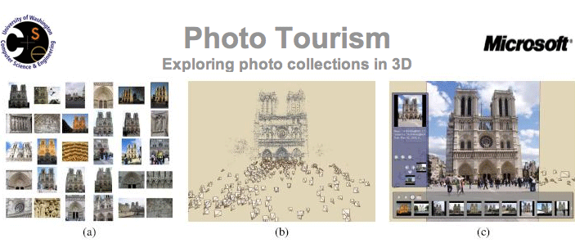
Photo tourism
Noah Snavely, Steven M. Seitz, Richard Szeliski, "Photo tourism: Exploring photo collections in 3D," SIGGRAPH 2006
http://phototour.cs.washington.edu/

Slide 63
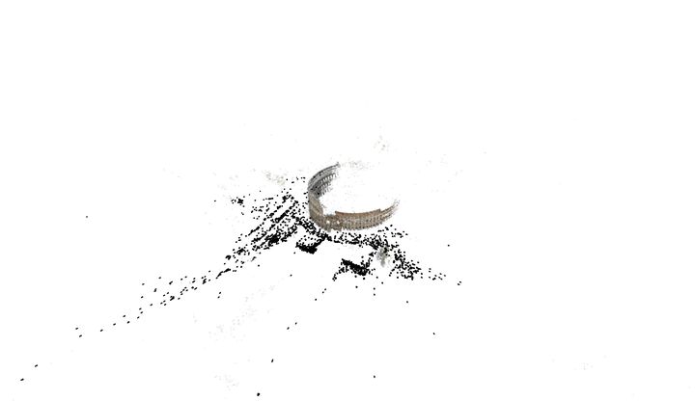
3D from multiple images
Sameer Agarwala, Noah Snavely, Ian Simon, Steven M. Seitz, Richard Szeliski, "Building Rome in a Day," ICCV 2009

